Slide 1
Earned Income Credit (EIC)
Pub 4012 Tab I
Pub 17 Chapter 36
(Federal 1040-Line 66a)
(NJ 1040-Line 51a)
Notes:
1

Slide 2
EIC – General Eligibility Requirements
Pub 4012 Tab I
Must have earned income
Most common sources are:
Wages, salaries & tips
Disability benefits received prior to minimum retirement age
Self-employment income
Household employee income
(full list in Pub 4012 Tab I)
Taxpayer & children must have SS #s valid for employment
Notes:
2
Some SS cards say “Not valid for employment.” The SS # may have been obtained to get a federally funded benefit

Slide 3
EIC – General Eligibility Requirements
Pub 4012 Tab I
(cont’d)
Not filing MFS
Citizen or resident alien all year
Investment income must be </= $3,350
Cannot be qualifying child of another person
Under specific AGI & earned income limitations(2014)
$47,747($53,267 MFJ)–3 or more qualifying children
$44,454($49,974 MFJ)-2 qualifying children
$39,131($44,651 MFJ)-1 qualifying child
$14,820($20,330 MFJ)-no qualifying child
Notes:
3

Slide 4
EIC – Additional Requirements With No Qualifying Child
Pub 4012 Tab I
At least 25 but under 65 as of 12/31
Cannot be the dependent or qualifying child of another person
Lived in US more than half the year
Notes:
4

Slide 5
EIC – Additional Requirements With Qualifying Child
Pub 4012 Tab I
Child meets qualifying relationship requirements
Child must have SS # valid for employment
Child under 19, OR under 24 & full-time student & younger than taxpayer, OR any age & permanently & totally disabled
Child did not file a joint return
Child lived with taxpayer over half the year
Child is unmarried BUT see Pub 17 for exceptions
Qualifying Child does NOT have to be a dependent
Notes:
5

Slide 6
EIC – Qualifying Child of More than One Person
Pub 4012 Tab I
If child meets conditions to be qualifying child of more than one person, only one person can claim child
Tie-Breaker Rule for who can claim (in order):
Parent
Parent with whom child lived longest
Parent with highest AGI
If no one is the parent, person with highest AGI
NOTE: TaxAide counselor will never invoke Tie-Breaker Rules; that’s an IRS function
Notes:
6

Slide 7
How EIC Is Determined
Amount of EIC based on:
Filing status
Number of qualifying children (0, 1, 2, 3)
Higher of earned income or AGI
Assume ALL children qualify for EIC (DO NOT make determination on your own):
Check “EIC” box for each person in Dependent section of Main Information Sheet
List children from youngest to oldest
Notes:
7
If you don’t put dependents in age order from youngest to oldest, you may not agree with refund monitor

Slide 8
How EIC Is Determined
(cont’d)
Use TW Schedule EIC Worksheet
Questions to see if you can claim EIC
Most already answered by TW from prior input
Complete only unanswered questions in RED
Answer questions in order
Be sure to follow “go to” instructions
TW calculates automatically if taxpayer is EIC eligible
If any child does not qualify, counselor should remove check for that child from Main Info screen
Notes:
8

Slide 9
EIC Amounts for 2014
Maximum EIC amounts for 2014
$6,242 with three or more qualifying children
$5,548 with two qualifying children
$3,359 with one qualifying child
$503 with no qualifying children
Notes:
9
This is just to give you an idea of the EIC amounts for 2014. TW automatically calculates this credit

Slide 10
Schedule EIC
Required if taxpayer has qualifying children
Complete unanswered questions that appear in RED in sequential order
If there are any RED marks on Line 4 (age/disability), answer 4a OR 4b, not both
Do NOT click on any boxes that are not still in RED
Notes:
03Filing Status 2008x
10

Slide 11
TW EIC on Main Info Screen
Notes:
When entering data on Main Info Screen, check the EIC box for all children.
While completing the tax return, complete the Schedule EIC & then Schedule EIC worksheet
If TW determines that a child does not qualify for EIC, go back to Main Info sheet & uncheck the EIC column for that child. If you forget to do this, an error will be generated during diagnostics.
11

Slide 12
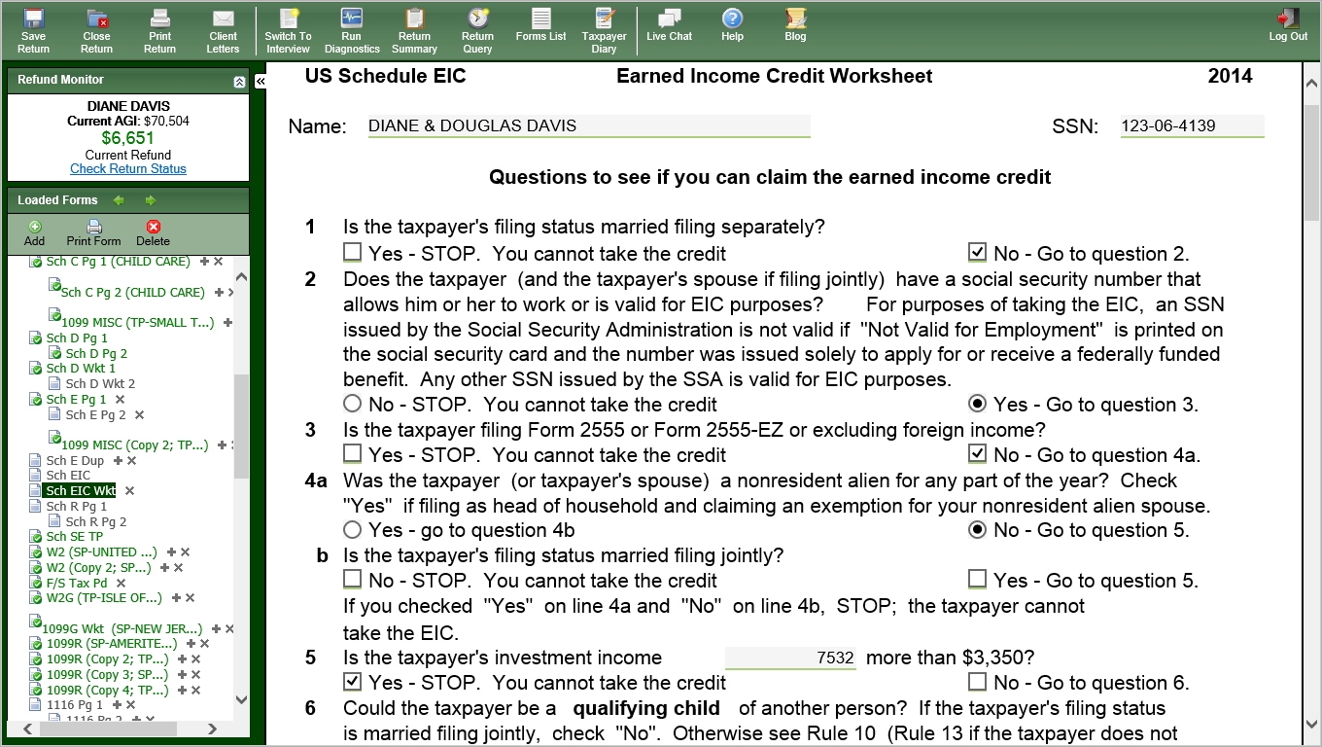
TW Schedule EIC Worksheet
NOTE: Answer questions underlined in red in order.
Follow “Go To “ directions
Notes:
Pull up Earned Income Credit Worksheet screen by clicking on Sch EIC Wkt in Forms Tree
Answer only questions underlined in red. Be sure to follow directions that tell you which question to answer next
TW will determine if taxpayer can claim the EIC & will calculate correct credit amount
12

Slide 13
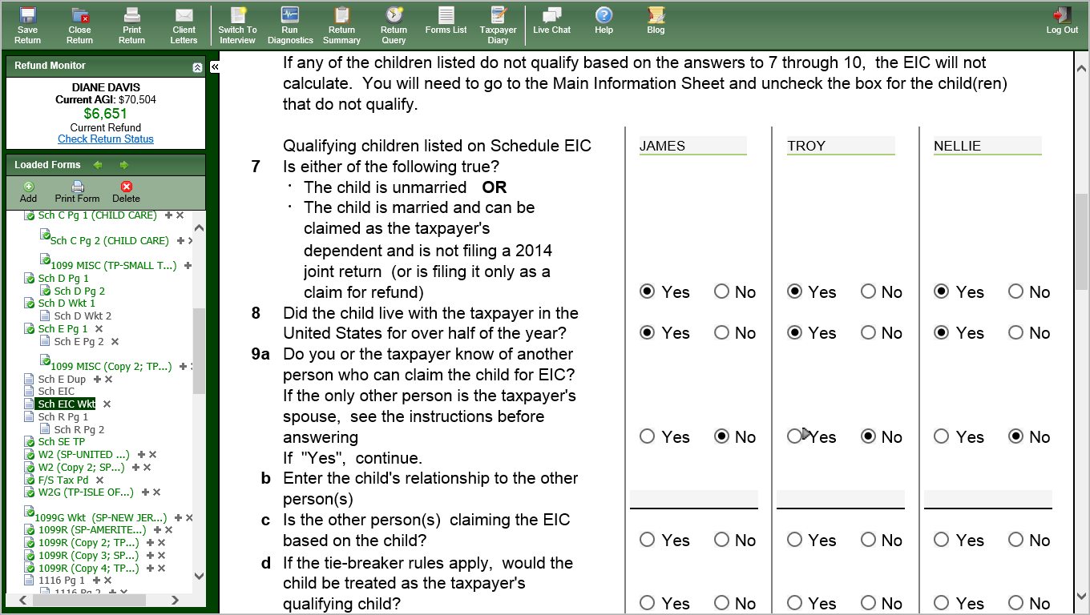
TW Schedule EIC Worksheet
Uncheck box on Main Info screen
for any child who does not qualify
NOTE: Answer questions underlined in red in order.
Follow “Go To “ directions
Notes:
Pull up Earned Income Credit Worksheet screen by clicking on Sch EIC Wkt in Forms Tree
Answer only questions underlined in red. Be sure to follow directions that tell you which question to answer next
TW will determine if taxpayer can claim the EIC & will calculate correct credit amount
If any of the children listed do not qualify based on the answers to Lines 7 – 10, the EIC will not calculate. Go back to the Main Info screen and uncheck the EIC box for the children who do not qualify
13

Slide 14
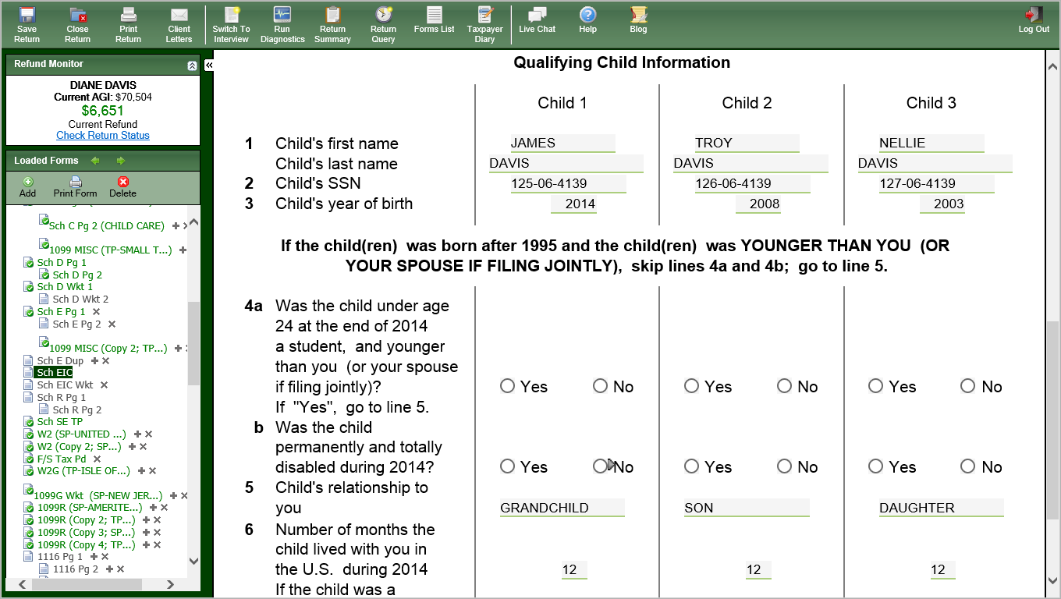
TW Schedule EIC NOTE: If you check Yes in 4a, & either Yes or No in 4b, the return will not pass Diagnostics. Follow “Go To” directions
NOTE: Answer questions underlined in red in order.
Follow “Go To “ directions
Notes:
Schedule EIC is required if taxpayer has qualifying children
If child was under age 19 at end of 2014 & younger than taxpayer/spouse, skip Lines 4a & 4b. Go to Line 5
If there are any RED marks on Line 4 (age/disability), answer 4a OR 4b, not both
Do NOT click on any boxes that are not still in RED
Follow “Go To” Directions
14

Slide 15
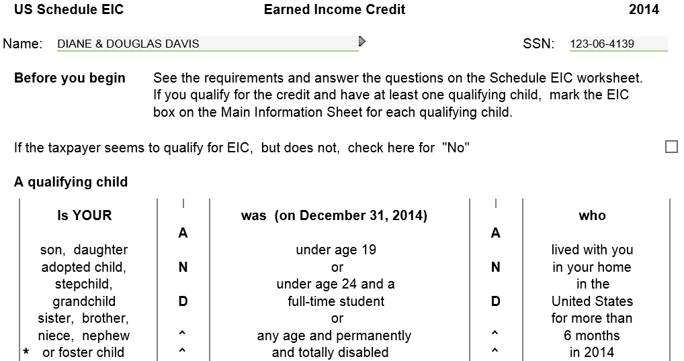
Do NOT check this box even if it is RED. That will disallow EIC & you’ll never know why.
Notes:
15

Slide 16
Disallowed EIC
Form 8862 must be attached to return if prior year EIC claim was denied or reduced for any reason other than a math or clerical error
If claim denied due to reckless or intentional disregard of EIC rules, cannot claim for 2 tax years
If fraud, cannot claim for 10 tax years
Notes:
16

Slide 17
Other Considerations
For EIC, support is not an issue
Under rules for divorced/separated parents, only custodial parent qualifies for EIC, no matter who claims dependent
Notes:
03Filing Status 2008x
17

Slide 18
NJ Earned Income Tax Credit (EITC)
Residents who are eligible & file for Federal EIC may also apply for a NJ EITC
Client may have Federal earned income, but no NJ earned income (e.g. – disability, third-party sick pay). Still eligible for NJ EITC
NJ EITC = 20% of Federal EIC
TW calculates automatically on NJ 1040 Line 51a
Before issuing refund checks, NJ checking EITC claims carefully to reduce fraud
IRS also checks for fraud, but takes a while. NJ does not want to issue refunds and then have to recover money

Slide 19
NJ Earned Income Tax Credit (EITC) Fraud Detection Measures
NJ checks EITC claims carefully. Frequently sends out requests for additional info
Federal tax account transcript – includes original Federal return, amended return, other IRS letters
SS cards for taxpayer and dependents - to track across years and geography
Birth certificate/guardianship documents for kids
May definitely delay refunds
Also sends out requests to explain differences between Federal and NJ pension amounts
Military pensions, 3-year rule, etc.

Slide 20
TW EITC - NJ 1040 Line 51a Worksheet
Notes:
NJ requires nondependent EITC qualifying people to be listed on return (Code 0 on Main Info screen).
TaxWise does not transfer Code 0 people automatically to NJ return.
Requires manual entry (covered in later module)
20

